Slide 1
Lesson 15 Day 1
You need your book, pencil, journal, and workbook.
Tancie West
3rd Grade
John s. Jones Elementary

Slide 2
issue
An issue is an edition of a newspaper or magazine.
The word is..
issue
What is the word?
issue
Would you want to read the latest issue of a magazine? Explain.
Where can you find the newest issue of your favorite magazine?

Slide 3
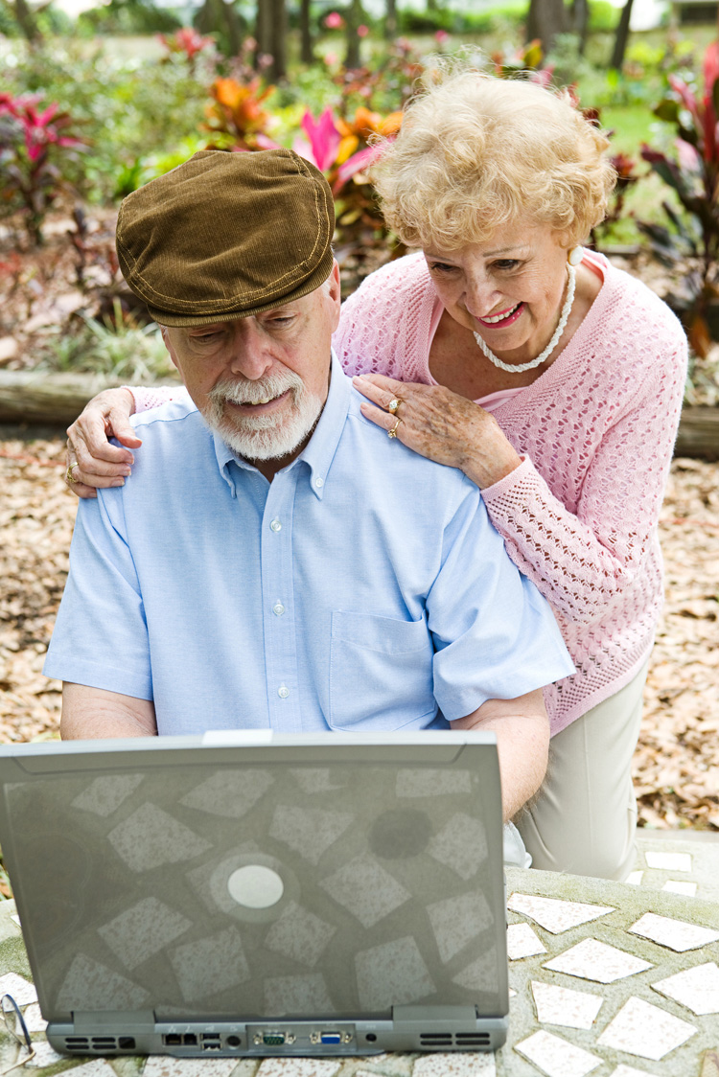
advice
I f you give someone advice, you tell what you think the person should do.
The word is..
advice
What is the word?
advice
Who might you ask for advice about a problem? Why?
Where could you get advice about what kind of bike to buy?

Slide 4
consult
When you consult someone, you ask him or her for information.
The word is..
consult
What is the word?
consult
When might you consult with me?
Why might you consult a librarian?

Slide 5
recommend
When you recommend something, you tell someone that you think it is good.
The word is..
recommend
What is the word?
recommend
If you disliked a movie, would you recommend it?
What book would you recommend to a friend?

Slide 6
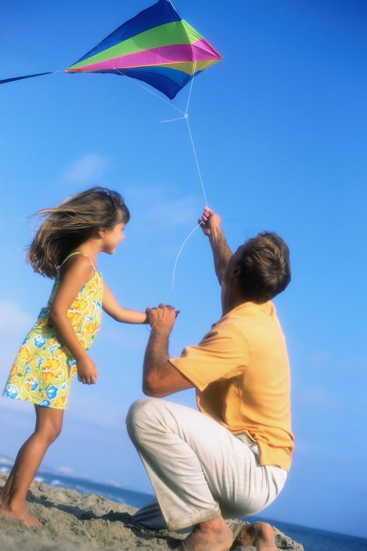
sensible
Someone who is sensible make good decisions and judgments.
The word is…
sensible
What is the word?
sensible
Is it sensible to go for a walk during a thunderstorm?
When is it sensible to fly a kite?

Slide 7
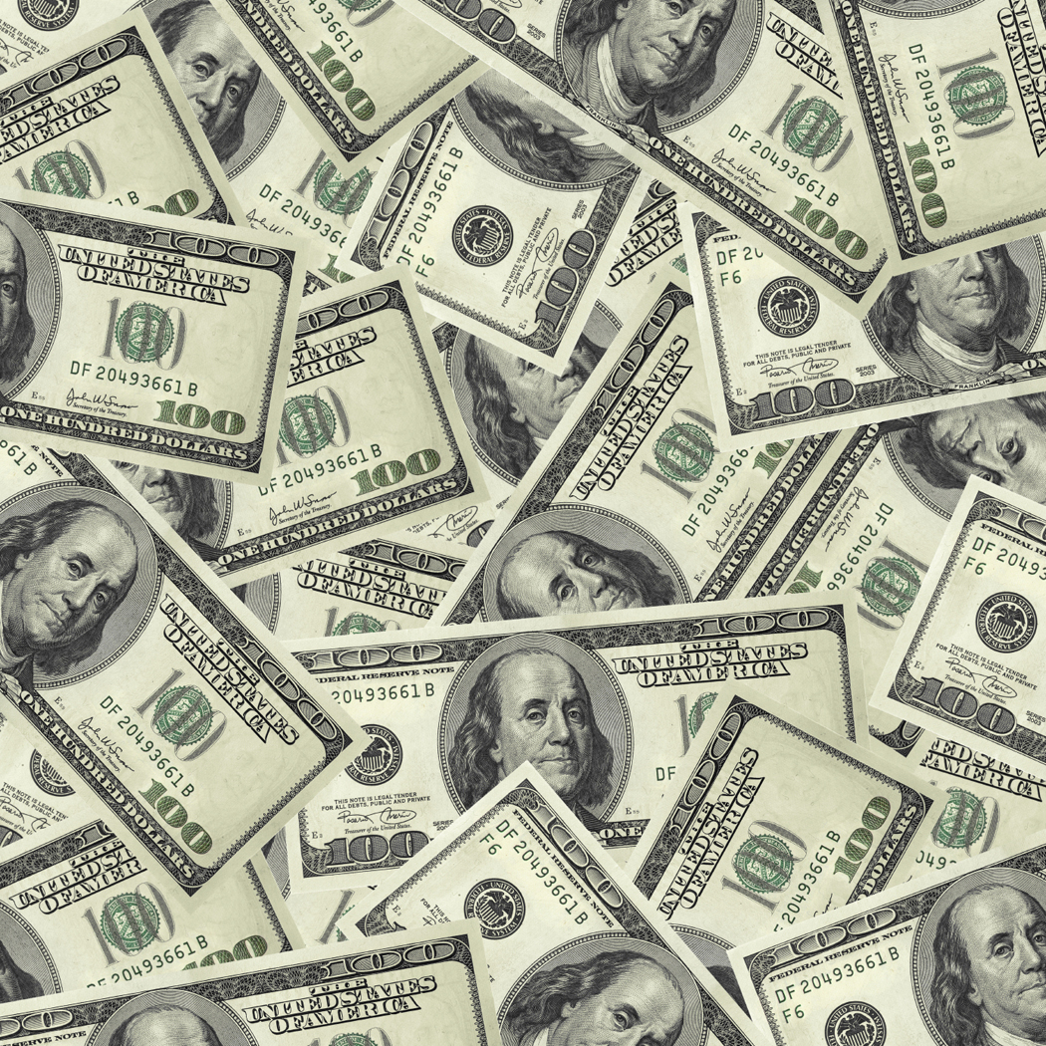
devise
To devise is to figure out a way to do something.
The word is…
devise
What is the word?
devise
What might you do to devise a plan to save money?
When might you need to devise a plan?

Slide 8

expertise
If someone has expertise, he or she knows a lot about a particular topic or skill.
The word is…
expertise
What is the word?
expertise
Healthy Heart uses her expertise on healthy habits to answer the question about exercise.
Whose expertise do we depend on to make us healthy again when we are ill?

Slide 9
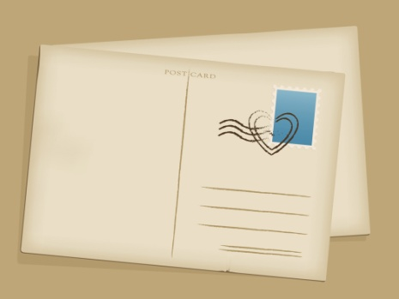
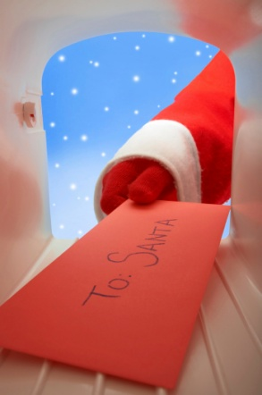
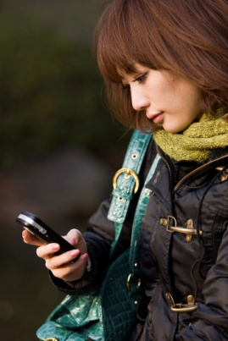
correspondence
If you send correspondence, you are communicating in writing.
The magazine staff read the correspondence sent in by the classroom.
The word is…
correspondence
What is the word?
correspondence
Do you prefer to send correspondence by writing a letter or by using e-mail?
What are some different means of correspondence?

Slide 10
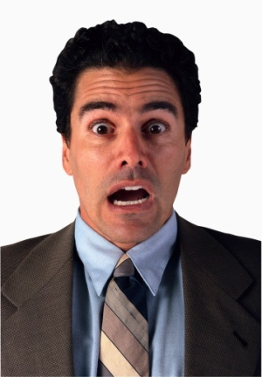
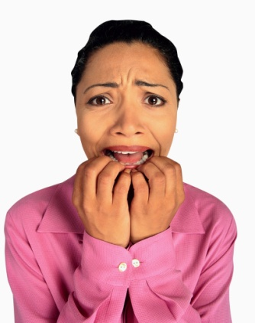
shudder
If you shudder, you are trembling from fear or from being cold.
The low, rumbling sound of thunder makes the windows shudder in their panes.
The word is…
shudder
What is the word?
shudder
Which sound is more likely to make you shudder – a loud crashing noise or the sound of a fountain?
What might make a person shudder?
Imagine one of those things has happened. How would you look?

Slide 11
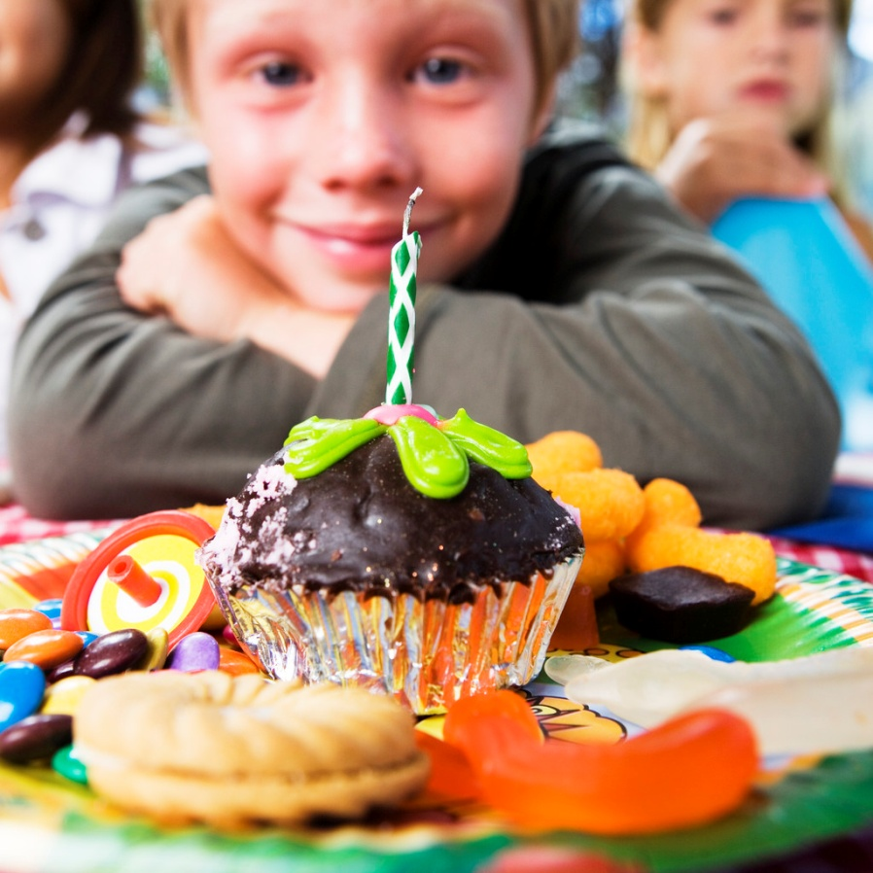
luscious
Something that is luscious appeals to your senses, such as you sense of taste.
The boy picked three luscious tomatoes for dinner.
The word is…
luscious
What is the word?
luscious
Would you think a slice of melon or a slice of onion is luscious?
What do you think is the most luscious food?
What would you do or say if you had just eaten some of that food?

